Slide 1
Tips for Training Deep Neural Network
Hung-yi Lee
Notes:
Do momemtum, adagrad
Q:
1. In ReLU, should I mention sparce
Q:
Why mean = 0?
ReLI not gradient vanish
adadelta
8
3: normalization, parameter initialization, activation function,
3: cost, parameter update
2:generalization,
Activations: 10p
Dropout: 10p
not mention: ensemble, regularization, experiment, maxout is for dropout
Adaptive gradient
Not mention:Adadelta, Adam, Windowgrad(?), Adasecond(I do not understand)
What I don’t know: why adagrad and rmsprop use square instead of mean
Not mention:
http://cs.stanford.edu/people/karpathy/convnetjs/demo/trainers.html

Slide 2
Announcement
分組
請確認在 ceiba 上的分組是否正確
HW1
截止日期: 10/23 2:00 p.m. (下週五上課前)
HW2
公告日期: 10/23
截止日期: 11/13 2:00 p.m.
比第一堂課公告的提早一週截止
Notes:
未完成
Cost (morning)
ReLU
mean
Adagrad
Eearly stopping

Slide 3
Outline
Data Preprocessing
Optimization
Generalization
Activation Function
Cost Function

Slide 4
Outline
Data Preprocessing
Optimization
Generalization
Activation Function
Cost Function

Slide 5
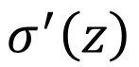
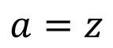
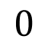
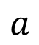
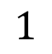
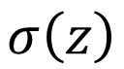
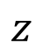
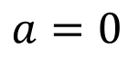
ReLU
Rectified Linear Unit (ReLU)
$$σ\left(z\right)$$
$$σ^{′}\left(z\right)$$
$$a$$
$$a$$
$$a=z$$
$$1$$
$$a=0$$
$$0$$
$$z$$
$$z$$
Notes:
Ref: Glorot, Xavier, Antoine Bordes, and Yoshua Bengio. "Deep sparse rectifier neural networks." International Conference on Artificial Intelligence and Statistics. 2011.
No differentailalbe how about 0

Slide 6
ReLU
Rectified Linear Unit (ReLU)
Reason:
$$σ\left(z\right)$$
1. Fast to compute
$$a$$
$$a=z$$
2. Biological reason
3. Infinite sigmoid with different biases
$$a=0$$
$$z$$
4. Vanishing gradient problem
Notes:
Parametric ReLU, -> PReLU
Ref: Glorot, Xavier, Antoine Bordes, and Yoshua Bengio. "Deep sparse rectifier neural networks." International Conference on Artificial Intelligence and Statistics. 2011.
No differentailalbe how about 0
Benefit:
2011
Where does it come from?
fast to compute
biology?
many sigmoid

Slide 7
Review: Backpropagation
Error signal
Layer
Layer
Forward Pass
Backward Pass
…
…
…
…

Slide 8
Review: Backpropagation
Error signal
Layer L-1
Layer L
……
Backward Pass
……
…
…
……
…
…

Slide 9
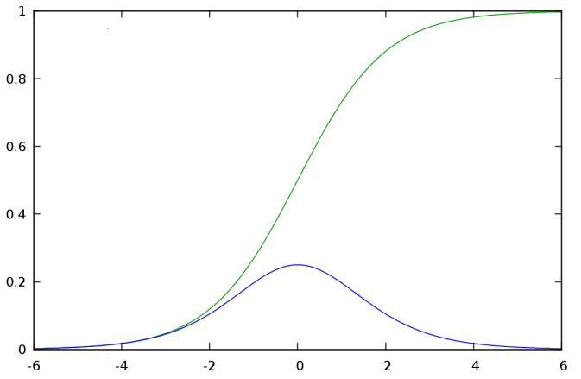
Problem of Sigmoid
Sigmoid Function
Derivative of Sigmoid Function
Derivative of Sigmoid Function is always smaller than 1

Slide 10
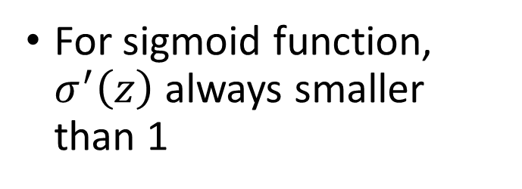
Vanishing Gradient Problem
Backward Pass:
Layer L-1
Layer L
For sigmoid function, $σ^{′}\left(z\right)$ always smaller than 1
……
Error signal is getting smaller and smaller
……
Gradient is smaller
…
…
……
…
…

Slide 11
Vanishing Gradient Problem
Input
Layer 1
Layer 2
Layer L
Output
……
vector
x
……
vector
y
……
……
……
……
……
…
Learn very slowly
Learn faster
Still random
Already converge
The weights are converged based on random!?
Notes:
Stuck at a bad local minima
When deep learning is difficult in early year
Need initialization
Another point of view
Definition of gradient

Slide 12
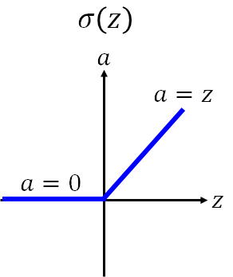
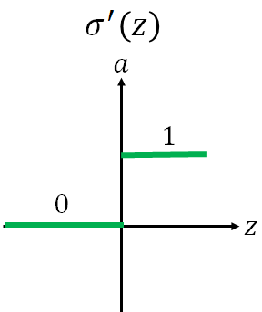
ReLU
Backward Pass:
Layer L-1
Layer L
……
……
…
…
……
…
…

Slide 13
ReLU
Backward Pass:
Layer L-1
Layer L
……
0
1
……
1
1
…
…
……
1
0
…
…

Slide 14
ReLU
Backward Pass:
Layer L-1
Layer L
1
……
1
1
…
……
A thinner network without any attenuation
1
…

Slide 15
ReLU
0
Input
Output
0
0
0

Slide 16
ReLU
A Thinner linear network
Input
Output
I have good influence to the output.

Slide 17
ReLU
Backward Pass:
All the weights connected to this neuron will not update.
Layer L
1
0
Possible solution:
…
1. softplus
2. Initialize with large bias
0
…
Notes:
solution
1. softplus ln(1+ e^x)
2. init with larger bias

Slide 18
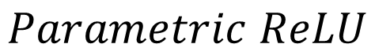
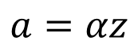
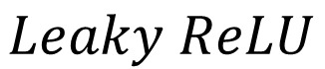
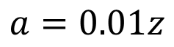
ReLU - variant
$$Leaky ReLU$$
$$Parametric ReLU$$
$$a$$
$$a$$
$$a=z$$
$$a=z$$
$$z$$
$$z$$
$$a=0.01z$$
$$a=αz$$
α also learned by gradient descent

Slide 19
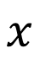
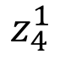
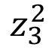
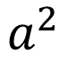
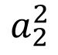
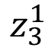
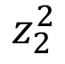
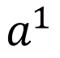
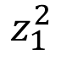
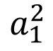
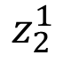
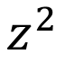
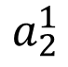
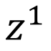
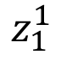
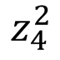
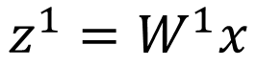
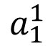
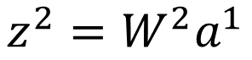
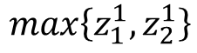
Maxout
All ReLU variants are just special cases of Maxout
+
$$z_{1}^{1}$$
+
$$z_{1}^{2}$$
Input
Max
$$a_{1}^{1}$$
Max
$$a_{1}^{2}$$
+
$$z_{2}^{1}$$
+
$$z_{2}^{2}$$
$$max\left\{z_{1}^{1},z_{2}^{1}\right\}$$
+
$$z_{3}^{1}$$
+
$$z_{3}^{2}$$
Max
$$a_{2}^{1}$$
Max
$$a_{2}^{2}$$
$$x$$
+
$$z_{4}^{1}$$
$$a^{1}$$
+
$$z_{4}^{2}$$
$$a^{2}$$
$$z^{1}$$
$$z^{2}$$
$$z^{1}=W^{1}x$$
$$z^{2}=W^{2}a^{1}$$
Notes:
How to train? Latter
2013
Ian J. Goodfellow goodfeli@iro.umontreal.ca David Warde-Farley wardefar@iro.umontreal.ca Mehdi Mirza mirzamom@iro.umontreal.ca Aaron Courville aaron.courville@umontreal.ca Yoshua Bengio

Slide 20
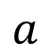

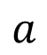
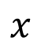
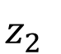

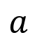
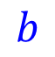
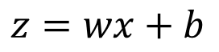
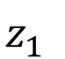
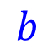
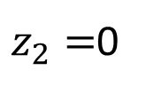

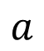
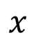

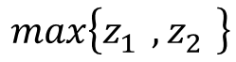
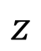

Maxout – ReLU is special case
+
$$z_{1}^{}$$
$$z$$
ReLU
Input
$$w$$
$$a$$
Input
$$w$$
Max
$$b$$
$$a$$
$$0$$
+
$$z_{2}^{}$$
$$max\left\{z_{1}^{},z_{2}^{}\right\}$$
$$b$$
$$0$$
$$a$$
$$a$$
$$z=wx+b$$
$$z_{1}=wx+b$$
$$x$$
$$x$$
$z_{2}=$0

Slide 21



Maxout – ReLU is special case
+
$$z_{1}^{}$$
$$z$$
ReLU
Input
$$w$$
$$a$$
Input
$$w$$
Max
$$b$$
$$a$$
+
$$z_{2}^{}$$
$$w^{′}$$
$$max\left\{z_{1}^{},z_{2}^{}\right\}$$
$$b$$
$$b^{′}$$
Learnable Activation Function
$$a$$
$$a$$
$$z=wx+b$$
$$z_{1}=wx+b$$
$$x$$
$$x$$
$$z_{2}=w^{′}x+b^{′}$$

Slide 22
Maxout - Training
Given a training data x, we know which z would be the max
+
$$z_{1}^{1}$$
+
$$z_{1}^{2}$$
Input
Max
$$a_{1}^{1}$$
Max
$$a_{1}^{2}$$
+
$$z_{2}^{1}$$
+
$$z_{2}^{2}$$
$$max\left\{z_{1}^{1},z_{2}^{1}\right\}$$
+
$$z_{3}^{1}$$
+
$$z_{3}^{2}$$
Max
$$a_{2}^{1}$$
Max
$$a_{2}^{2}$$
$$x$$
+
$$z_{4}^{1}$$
$$a^{1}$$
+
$$z_{4}^{2}$$
$$a^{2}$$

Slide 23
Maxout - Training
Given a training data x, we know which z would be the max
Train this thin and linear network
+
$$z_{1}^{1}$$
+
$$z_{1}^{2}$$
Input
$$a_{1}^{1}$$
$$a_{1}^{2}$$
+
$$z_{2}^{1}$$
+
$$z_{2}^{2}$$
+
$$z_{3}^{1}$$
+
$$z_{3}^{2}$$
$$x$$
$$a_{2}^{1}$$
$$a_{2}^{2}$$
+
$$z_{4}^{1}$$
$$a^{1}$$
+
$$z_{4}^{2}$$
$$a^{2}$$

Slide 24
Outline
Data Preprocessing
Optimization
Generalization
Activation Function
Cost Function

Slide 25
Cost Function
Layer L
(Output layer)
Layer L-1
…
…
…
…
…
…
…
…

Slide 26



Output Layer
$$y=\left[\begin{aligned}0 \\ 0 \\ ⋮ \\ 1.2 \\ ⋮\end{aligned}\right]$$
ReLU
$$\hat{y}=\left[\begin{aligned}0 \\ 0 \\ ⋮ \\ 1 \\ ⋮\end{aligned}\right]$$
More similar?
$$y=\left[\begin{aligned}0 \\ 0 \\ ⋮ \\ 2 \\ ⋮\end{aligned}\right]$$
Larger output means larger confidence
Classification Task:
ReLU
Only one dimension is 1, and others are all 0
Better?
It is better to let the output bounded.

Slide 27
Softmax
Softmax layer as the output layer
Ordinary Output layer
Notes:
Original output layer is local

Slide 28

Softmax
Probability:
$1>y_{i}>0$
$\sum_{i}{y_{i}=1}$
Softmax layer as the output layer
Softmax Layer
3
20
0.88
1
2.7
0.12
-3
0.05
≈0
Notes:
Why it is name soft max?
Monotonicity of softmax
Non-locality of softmax

Slide 29
Softmax
What kind of cost function should we used for softmax layer output?
?
Big
Difference
Softmax
…
…
…
Large
Error Signal
…
…
…
Notes:
Of course, you can use two norm
But not fulfill this idea

Slide 30



Softmax
$$C=−logy_{r}$$
Define cost:
Cross Entropy
Do we have to consider other dimensions?
Only one dimension is 1, and others are all 0
$$\hat{y}=\left[\begin{aligned}0 \\ 0 \\ ⋮ \\ 1 \\ ⋮\end{aligned}\right]$$
Softmax
…
…
…
$$r$$
Index of the dimension which is 1
…
…
…

Slide 31



Softmax
…
…
…
$$C=−logy_{r}$$
1
…
…
…
The absolute value of $δ_{r}^{L}$ is larger when $y_{r}$ is far from 1
$z_{r}^{L}$ appears in both numerator and denominator
Notes:
Cross entropy

Slide 32



Softmax
…
…
…
$$C=−logy_{r}$$
0
…
…
…
$$i≠r$$
The absolute value of $δ_{i}^{L}$ is larger when $y_{i}$ is larger
$z_{i}^{L}$ appears only in denominator
Notes:
Cross entropy

Slide 33
Outline
Data Preprocessing
Optimization
Generalization
Activation Function
Cost Function

Slide 34








Normalizing Input
For each dimension i:
……
……
mean: $m_{i}$
……
……
……
……
……
standard deviation: $σ_{i}$
$$x^{1}$$
$$x^{2}$$
$$x^{3}$$
$$x^{r}$$
$$x^{R}$$
$$x_{i}^{r}←\frac{x_{i}^{r}−m_{i}}{σ_{i}}$$
The means of all dimensions are 0, and the variances are all 1
Notes:
https://standardfrancis.wordpress.com/2015/04/16/batch-normalization/

Slide 35



Normalizing Input
Source of figure: http://cs231n.github.io/neural-networks-2/
Normalizing your training and testing data in the same way.

Slide 36
Outline
Data Preprocessing
Optimization
Generalization
Activation Function
Cost Function

Slide 37














Vanilla Gradient Descent
$$∇C\left(θ^{0}\right)$$
Start at position $θ^{0}$
$$∇C\left(θ^{1}\right)$$
Compute gradient at $θ^{0}$
$$θ^{0}$$
$$θ^{1}$$
Move to $θ^{1}$ = $θ^{0}$ - η$∇C\left(θ^{0}\right)$
$$∇C\left(θ^{2}\right)$$
Compute gradient at $θ^{1}$
$$θ^{2}$$
Gradient
$$∇C\left(θ^{3}\right)$$
Move to $θ^{2}$ = $θ^{1}$ – η$∇C\left(θ^{1}\right)$
Movement
$$θ^{3}$$
……
Stop until $∇C\left(θ^{t}\right)≈0$
How to determine the learning rates
Stuck at local minima or saddle points
Notes:
平凡的；普通的；乏味的

Slide 38
Outline
Data Preprocessing
Optimization
Generalization
Activation Function
Cost Function
Learning Rate
Momentum

Slide 39
Outline
Data Preprocessing
Optimization
Generalization
Activation Function
Cost Function
Learning Rate
Momentum

Slide 40

Learning Rates
Source: http://neuralnetworksanddeeplearning.com/chap3.html

Slide 41

Learning Rates
Popular & Simple Idea: Reduce the learning rate by some factor every few epochs.
At the beginning, we are far from the destination, so we use larger learning rate
After several epochs, we are close to the destination, so we reduce the learning rate
E.g. 1/t decay: $η^{t}=η/{\sqrt{t+1}}$
Learning rate cannot be one-size-fits-all
Give different parameters different learning rates
Notes:
Advanced Idea: Eta
Can we give each parameters different learning rates?

Slide 42





Adagrad
$$g^{t}=\frac{∂C\left(θ^{t}\right)}{∂w}$$
$$η^{t}=\frac{η}{\sqrt{t+1}}$$
Divide the learning rate of each parameter by the root mean square of its previous derivatives
Vanilla Gradient descent
$$w^{t+1}←w^{t}−{\text{η}}^{t}g^{t}$$
w is one parameters
Adagrad
$σ^{t}$: root mean square of the previous derivatives of parameter w
$$w^{t+1}←w^{t}−\frac{{\text{η}}^{t}}{σ^{t}}g^{t}$$
Parameter dependent

Slide 43










Adagrad
$σ^{t}$: root mean square of the previous derivatives of parameter w
$$w^{1}←w^{0}−\frac{{\text{η}}^{0}}{σ^{0}}g^{0}$$
$$σ^{0}=g^{0}$$
$$σ^{1}=\sqrt{\frac{1}{2}\left[{\left(g^{0}\right)}^{2}+{\left(g^{1}\right)}^{2}\right]}$$
$$w^{2}←w^{1}−\frac{{\text{η}}^{1}}{σ^{1}}g^{1}$$
$$σ^{2}=\sqrt{\frac{1}{3}\left[{\left(g^{0}\right)}^{2}+{\left(g^{1}\right)}^{2}+{\left(g^{2}\right)}^{2}\right]}$$
$$w^{3}←w^{2}−\frac{{\text{η}}^{2}}{σ^{2}}g^{2}$$
$$……$$
$$σ^{t}=\sqrt{\frac{1}{t+1}\sum_{i=0}^{t}{{\left(g^{i}\right)}^{2}}}$$
$$w^{t+1}←w^{t}−\frac{{\text{η}}^{t}}{σ^{t}}g^{t}$$
Notes:
Why square

Slide 44






Adagrad
Divide the learning rate of each parameter by the root mean square of its previous derivatives
$$η^{t}=\frac{η}{\sqrt{t+1}}$$
1/t decay
$${\text{η}}^{t}$$
$$w^{t+1}←w^{t}−\frac{η}{σ^{t}}g^{t}$$
$$σ^{t}=\sqrt{\frac{1}{t+1}\sum_{i=0}^{t}{{\left(g^{i}\right)}^{2}}}$$
$$σ^{t}$$
$$w^{t+1}←w^{t}−\frac{η}{\sqrt{\sum_{i=0}^{t}{{\left(g^{i}\right)}^{2}}}}g^{t}$$

Slide 45




Contradiction?
$$g^{t}=\frac{∂C\left(θ^{t}\right)}{∂w}$$
$$η^{t}=\frac{η}{\sqrt{t+1}}$$
Vanilla Gradient descent
Larger gradient,
larger step
$$w^{t+1}←w^{t}−{\text{η}}^{t}g^{t}$$
Adagrad
Larger gradient,
larger step
$$w^{t+1}←w^{t}−\frac{η}{\sqrt{\sum_{i=0}^{t}{{\left(g^{i}\right)}^{2}}}}g^{t}$$
Larger gradient, smaller step
Notes:
Contradiction??????

Slide 46

Intuitive Reason
反差
g⁰ | g¹ | g² | g³ | g⁴ | ……
0.001 | 0.001 | 0.003 | 0.002 | 0.1 | ……
g⁰ | g¹ | g² | g³ | g⁴ | ……
10.8 | 20.9 | 31.7 | 12.1 | 0.1 | ……
$$w^{t+1}←w^{t}−\frac{η}{\sqrt{\sum_{i=0}^{t}{{\left(g^{i}\right)}^{2}}}}g^{t}$$
造成反差的效果
Notes:
http://seed.ucsd.edu/mediawiki/images/6/6a/Adagrad.pdf
http://courses.cs.washington.edu/courses/cse547/15sp/slides/adagrad.pdf
Some features can be extremely useful and informative to an optimization problem but they may not show up in most of the training instances or data. If, when they do show up, they are weighted equally in terms of learning rate as a feature that has shown up hundreds of times we are practically saying that the influence of such features means nothing in the overall optimization (it's impact per step in the stochastic gradient descent will be so small that it can practically be discounted). To counter this, AdaGrad makes it such that features that are more sparse in the data have a higher learning rate which translates into a larger update for that feature (i.e. in logistic regression that feature's regression coefficient will be increased/decreased more than a coefficient of a feature that is seen very often). Simply put, sparse features can be very useful. I don't have an example of application in neural network training. Different adaptive learning algorithms are useful with different data (it would really depend on what your data is and how much importance you place on sparse features).

Slide 47










Larger gradient, larger steps?
Best step:
$$|x_{0}+\frac{b}{2a}|$$
$$\frac{|2ax_{0}+b| }{2a}$$
$$x_{0}$$
$$−\frac{b}{2a}$$
$$y=ax^{2}+bx+c$$
$$|2ax_{0}+b|$$
$$\left|\frac{∂y}{∂x}\right|=|2ax+b|$$
$$x_{0}$$

Slide 48









Second Derivative
Best step:
$$|x_{0}+\frac{b}{2a}|$$
$$\frac{|2ax_{0}+b| }{2a}$$
$$−\frac{b}{2a}$$
$$x_{0}$$
$$y=ax^{2}+bx+c$$
$$|2ax_{0}+b|$$
$$\left|\frac{∂y}{∂x}\right|=|2ax+b|$$
$$x_{0}$$
$$\frac{∂^{2}y}{∂x^{2}}=2a$$
|First derivative|
The best step is
Second derivative
Notes:
You will ignore it in this case,
Because the second is always the saem
For taylor, second order is consdierd

Slide 49







More than one parameters
|First derivative|
The best step is
a > b
Second derivative
a
b
Smaller Learning Rate
$$w_{1}$$
smaller second derivative
c < a
c
$$w_{2}$$
c > d
Larger Learning Rate
d
$$w_{2}$$
$$w_{1}$$
Larger second derivative
Notes:
Larger Gradient
Smaller Learning
Rate

Slide 50






What to do with Adagrad?
The best step is
|First derivative|
Second derivative
Use first derivative to estimate second derivative
smaller second derivative
larger second derivative
$$w_{1}$$
$$w_{2}$$
$$\sqrt{{\left(first derivative\right)}^{2}}$$
Notes:
What would you see?

Slide 51
Outline
Data Preprocessing
Optimization
Generalization
Activation Function
Cost Function
Learning Rate
Momentum

Slide 52



Easy to stuck
cost
Very slow at the plateau
Stuck at saddle point
Stuck at local minima
$$∇C\left(θ^{t}\right)$$
$$≈0$$
$$∇C\left(θ^{t}\right)=0$$
$$∇C\left(θ^{t}\right)=0$$
parameter space

Slide 53
In physical world ……
Momentum
How about put this phenomenon in gradient descent?
Notes:
Momentum: 動量
if we were declared God for a day, and could make up our own laws of physics, dictating to the ball how it should roll, what law or laws of motion could we pick that would make it so the ball always rolled to the bottom of the valley?
In real life a ball has momentum, and that momentum may allow it to roll across the slope, or even (momentarily) roll uphill. It's only after the effects of friction set in that the ball is guaranteed to roll down into the valley.
there's even a sense in which gradient descent is the optimal strategy for searching for a minimum.
Prove the assertion of the last paragraph. Hint: If you're not already familiar with the Cauchy-Schwarz inequality, you may find it helpful to familiarize yourself with it.

Slide 54















Momentum
Movement: movement of last step minus gradient at present
Start at point $θ^{0}$
Movement v⁰=0
$$∇C\left(θ^{0}\right)$$
Compute gradient at $θ^{0}$
$$∇C\left(θ^{1}\right)$$
$$θ^{0}$$
Movement v¹ = λv⁰ - η$∇C\left(θ^{0}\right)$
$$θ^{1}$$
Move to $θ^{1}$ = $θ^{0}$ + v¹
$$∇C\left(θ^{2}\right)$$
Compute gradient at $θ^{1}$
$$θ^{2}$$
Gradient
Movement v² = λv¹ - η$∇C\left(θ^{1}\right)$
Movement
Move to $θ^{2}$ = $θ^{1}$ + v²
$$θ^{3}$$
$$∇C\left(θ^{3}\right)$$
Movement not just based on gradient, but previous movement.
Movement
of last step

Slide 55



Momentum
Movement: movement of last step minus gradient at present
Start at point $θ^{0}$
Movement v⁰=0
Compute gradient at $θ^{0}$
v^{i} is actually the weighted sum of all the previous gradient: $∇C\left(θ^{0}\right)$,$∇C\left(θ^{1}\right), …∇C\left(θ^{i−1}\right)$
Movement v¹ = λv⁰ - η$∇C\left(θ^{0}\right)$
Move to $θ^{1}$ = $θ^{0}$ + v¹
v⁰ = 0
Compute gradient at $θ^{1}$
v¹ = - η$∇C\left(θ^{0}\right)$
Movement v² = λv¹ - η$∇C\left(θ^{1}\right)$
Move to $θ^{2}$ = $θ^{1}$ + v²
v² = - λ η$∇C\left(θ^{0}\right)$ - η$∇C\left(θ^{1}\right)$
Movement not just based on gradient, but previous movement
……
Notes:
Lambda = 0.9

Slide 56
Momentum
cost
Negative of Gradient
Movement
Movement of last step
Gradient = 0
parameter space
Notes:
What can we see?

Slide 57


http://www.reddit.com/r/MachineLearning/comments/2gopfa/visualizing_gradient_optimization_techniques/cklhott (By Alec Radford)
Notes:
http://arxiv.org/pdf/1312.6055v3.pdf

Slide 58


http://www.reddit.com/r/MachineLearning/comments/2gopfa/visualizing_gradient_optimization_techniques/cklhott (By Alec Radford)
Notes:
Head of Research at indico

Slide 59
Outline
Data Preprocessing
Optimization
Generalization
Activation Function
Cost Function

Slide 60


Panacea
Have more training data
Create more training data (?)
Handwriting recognition:
Original Training Data:
Created Training Data:
Shift 15。
Notes:
In speech recognition:
add noise
warping

Slide 61
Outline
Data Preprocessing
Optimization
Generalization
Activation Function
Cost Function
Early Stopping
Weight Decay
Dropout

Slide 62
Outline
Data Preprocessing
Optimization
Generalization
Activation Function
Cost Function
Early Stopping
Weight Decay
Dropout

Slide 63

Early Stopping
How many parameter updates do we need?
Value of Cost Function
Stop at here
Validation set
Testing set
Training set
Number of parameter updates
Notes:
Validation set: The data set can used to evaluate your model but not involve in training.
Validation set: seplit from training data
Acturally is difficult
http://deeplearning.net/tutorial/mlp.html#mlp

Slide 64
Outline
Data Preprocessing
Optimization
Generalization
Activation Function
Cost Function
Early Stopping
Weight Decay
Dropout

Slide 65
Weight Decay
The parameters closer to zero is preferred.
Training data:
…
…
Testing data:
To minimize the effect of noise, we want w close to zero.
Notes:
Should we explain more here. Strat with how we select the model?
Regualrization do not put on thebias

Slide 66
Weight Decay
New cost function to be minimized
Find a set of weight not only minimizing original cost but also close to zero
Regularization term:
Original cost
(e.g. minimize square error, cross entropy …)
(not consider biases. why?)
Notes:
L1 is also good, subtle difference

Slide 67
Weight Decay
New cost function to be minimized
Gradient:
Update:
Smaller and smaller
Notes:
Smaller and smaller

Slide 68

Weight Decay
Our Brain

Slide 69
Outline
Data Preprocessing
Optimization
Generalization
Activation Function
Cost Function
Early Stopping
Weight Decay
Dropout

Slide 70

Dropout
$$θ^{t}←θ^{t−1}−η∇C_{x}\left(θ^{t−1}\right)$$
Training:
(stochastic gradient descent)
In each iteration
Each neuron has p% to dropout
Notes:
Iteration v.s. epoch!!!!!!!!

Slide 71
Dropout
$$θ^{t}←θ^{t−1}−η∇C_{x}\left(θ^{t−1}\right)$$
Training:
(stochastic gradient descent)
Thinner!
In each iteration
Each neuron has p% to dropout
The structured of the network is changed.
Using the new network for training
For each iteration, we resample the dropout neurons
Notes:
Do not worry that someone will not update

Slide 72

Dropout
Testing:
No dropout
If the dropout rate at training is p%, all the weights times (1-p)%
Assume that the dropout rate is 50%.
If $w_{ij}^{l}=1$ from training, set $w_{ij}^{l}=0.5$ for testing.

Slide 73


Dropout - Intuitive Reason
Testing
No dropout
(拿下重物後就變很強)
Training
Dropout (腳上綁重物)

Slide 74
Dropout - Intuitive Reason
我的 partner 會擺爛，所以我要好好做
When teams up, if everyone expect the partner will do the work, nothing will be done finally.
However, if you know your partner will dropout, you will do better.
When testing, no one dropout actually, so obtaining good results eventually.
Notes:
腳上綁重物 拿下來以後就可以飛
Why the weights should multiply p (dropout rate) at testing?

Slide 75
















Dropout - Intuitive Reason
Why the weights should multiply (1-p)% (dropout rate) when testing?
Training of Dropout
Testing of Dropout
Assume dropout rate is 50%
No dropout
Weights from training
$$w_{1}$$
$$0.5×$$
$$w_{1}$$
$$z^{′}≈2z$$
$$w_{2}$$
$$z$$
$$0.5×$$
$$w_{2}$$
$$z^{′}$$
$$w_{3}$$
$$0.5×$$
$$w_{3}$$
$$w_{4}$$
$$0.5×$$
$$w_{4}$$
Weights multiply (1-p)%
$$z^{′}≈z$$
Notes:
$$z=\sum{w_{i}a_{i}}$$

Slide 76
Dropout - Ensemble
Training Set
Ensemble
Set 1
Set 2
Set 3
Set 4
Network
1
Network
2
Network
3
Network
4
Train a bunch of networks with different structures

Slide 77
Dropout - Ensemble
Ensemble
Testing data x
Network
1
Network
2
Network
3
Network
4
y₁
y₂
y₃
y₄
average

Slide 78
Dropout - Ensemble
Dropout ≈ Ensemble.
Training of Dropout
x₁
x₂
x₃
x₄
M neurons
……
2^{M} possible networks
Using one data to train one network
Some parameters in the network are shared

Slide 79
Dropout - Ensemble
Dropout ≈ Ensemble.
Testing of Dropout
testing data x
All the weights multiply (1-p)%
……
y₁
y₂
y₃
?
≈
y
average
Notes:
0,0 -> 0
1,0 -> 1
0,-1 -> -2
1,-1 -> -1
½, -1/2 -> -0.5
1,2
Geometric Mean?

Slide 80


Dropout - Ensemble
Experiments on hand writing digital classification
Ref: http://arxiv.org/pdf/1302.4389.pdf

Slide 81
Practical Suggestion for Dropout
Larger network
If you know your task need n neurons, for dropout rate p, your network need n/(1-p) neurons.
Longer training time
Higher learning rate
Larger momentum
Notes:
In one epoch, a neuron can only see a fraction of training data
Larger momentum (?)
ReLu v.s. Drop

Slide 82
Concluding Remarks
Not covered today:
Parameters Initialization
http://neuralnetworksanddeeplearning.com/chap3.html#weight_initialization
Data Preprocessing
Optimization
Generalization
Activation Function
Cost Function
ReLU, Maxout
Softmax
+ Cross Entropy
Mean=0,
Variance=1
Adagrad, Momentum
Early Stopping, Weight decay, Dropout

Slide 83
Acknowledgement
感謝 李朋軒 同學糾正投影片上的錯誤
很多地方 p 應該改為 1-p
感謝 Ryan Sun 來信指出投影片上的錯誤

